Slide 1

SOFTWARE DESIGN
AND ARCHITECTURE
(SDA)
Chapter 4
UTM KUALA LUMPUR

Slide 2
01
INTRODUCTION
04
Intro to Architectural Style & Pattern
02
THE OLD ARCHITECTURAL
05
Mapping System, Pattern and Quality
03
THE NEW ARCHITECTURAL
06
Monolithic, Services, and etc..

Slide 3
SOFTWARE ARCHITECTURAL STYLE AND PATTERN
Architectural styles and architectural patterns provide generic, reusable solutions that can be easily understood
Generic View
Solutions
Understood
Standard diagrams with details
Completeness of solutions
Easy to understand
3

Slide 4
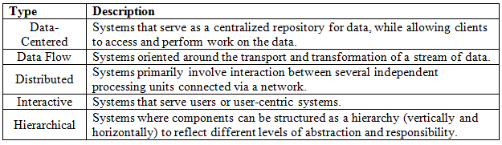
THE SYSTEM TYPE
No | System Type | Description
1 | Real-Time System | Real-time systems are designed to respond to events or inputs within a specified timeframe, often with stringent timing constraints.
2 | Embedded System | Embedded systems are specialized computing systems designed to perform specific tasks within larger systems or devices. They are typically embedded into other devices and often operate in real-time with limited resources.
3 | Adaptive System | Adaptive systems have the capability to change their behavior or structure based on internal or external conditions. They can learn from experience, adjust to new inputs, and optimize their performance over time
4

Slide 5
THE OLD ARCHITECTURAL
No | System Type | Architecture Pattern | Quality Attribute
1 | Data centred system | Blackboard | Modifiability Maintainability Reusability
2 | Data flow system | Pipes and Filters | Efficiency Modifiability Extensibility Maintainability Reusability Security
3 | Distributed system | Client and Server Broker | Interoperability Modifiability Availability Reusability
4 | Interactive system | Model View Controller (MVC) | Modifiability Usability Reusability
5 | Hierarchy system | Layered | Modifiability Portability Reusability Security
5

Slide 6
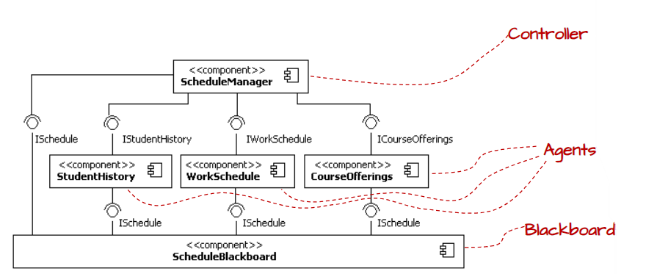
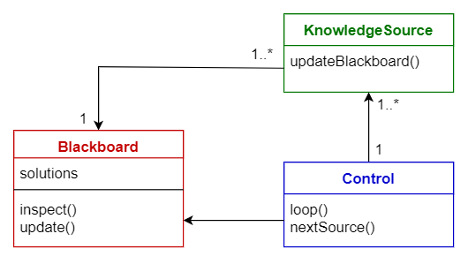
DATA CENTRED – BLACKBOARD ARCHITECTURAL PATTERN
6

Slide 7
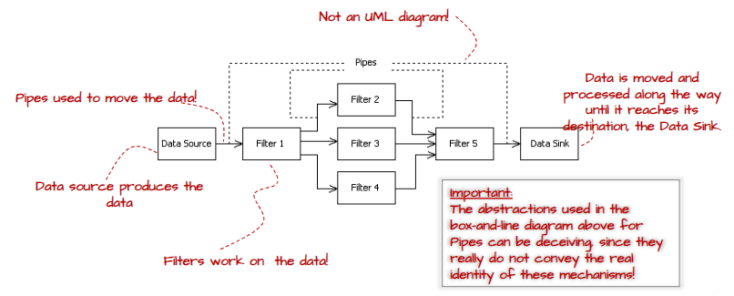
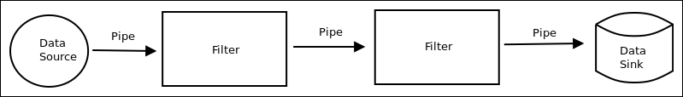
DATA FLOW – PIPES-AND-FILTERS ARCHITECTURAL PATTERN
7

Slide 8
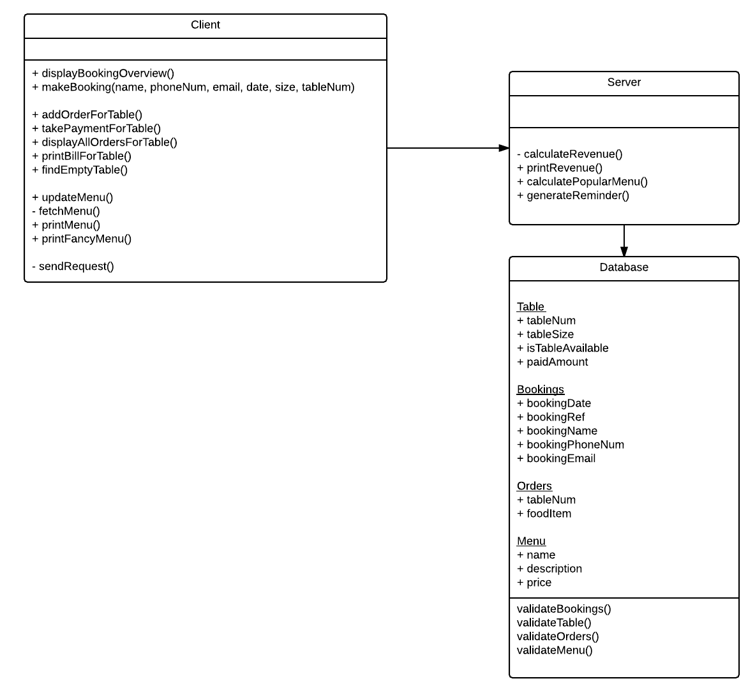
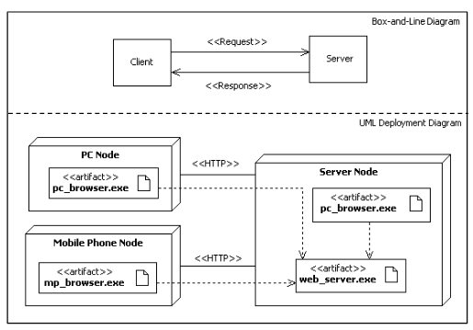
DISTRIBUTED – CLIENT AND SERVER ARCHITECTURAL PATTERN
8

Slide 9
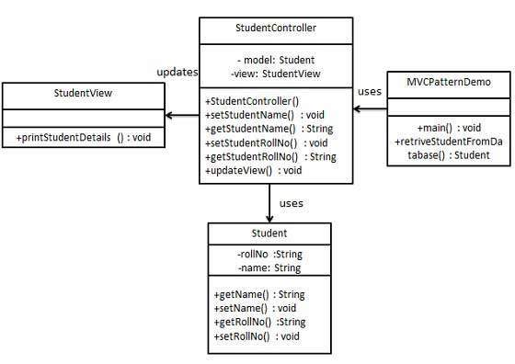
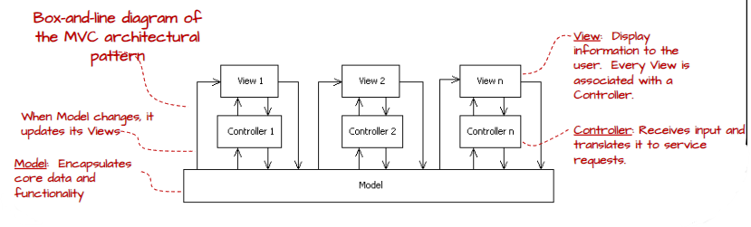
INTERACTIVE – MODEL VIEW CONTROLLER ARCHITECTURAL PATTERN
9

Slide 10
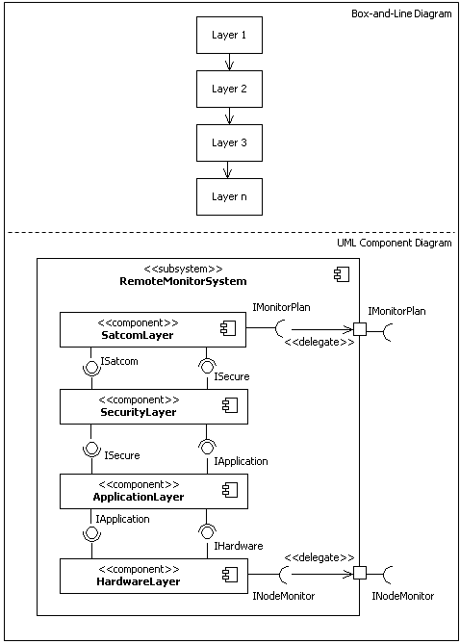
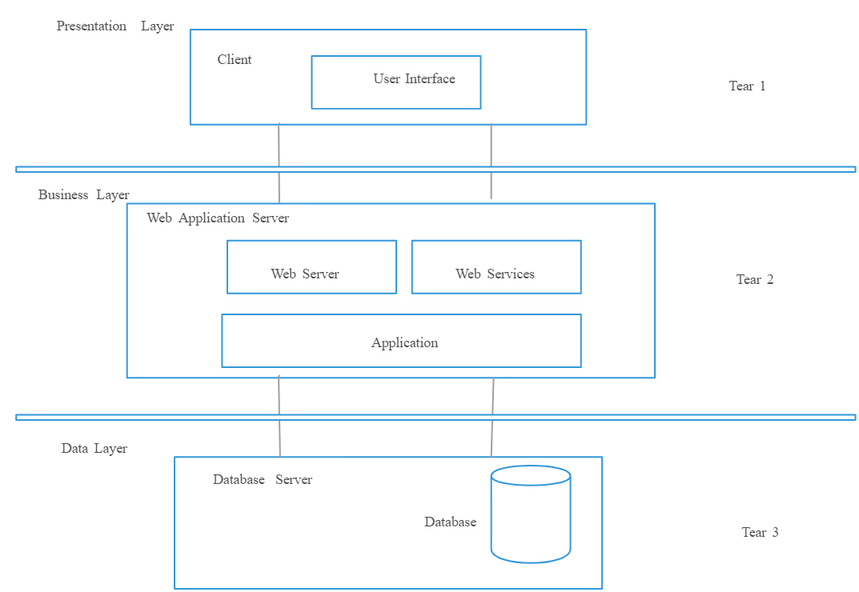
HIERARCHY – LAYERED ARCHITECTURAL PATTERN
10

Slide 11
THE NEW ARCHITECTURAL
No | System Type | Architecture Pattern | Quality Attribute
1 | Distributed system + Interactive system + Component based | Service Oriented Architecture (SOA) | Interoperability Modifiability Maintainability Availability Reusability
2 | Data flow system + Distributed system + Interactive system + Component based + Web Services | Microservices Architecture Serverless Architecture Event-Driven Architecture Hybrid Architecture | Efficiency Modifiability Extensibility Maintainability Reusability Security
5 | Hierarchy system + Interactive system + Component based | Modular Monolith Architecture | Modifiability Portability Reusability Maintainability Availability Reusability Security
11

Slide 12

Thank you for your participation. I am very grateful to have the opportunity into this sharing session. If there any enquiries, feels free to contact me.
+013 509 9215
khatibsyarbini@utm.my

Slide 13

THANK YOU
In the Name of God for Mankind
univteknologimalaysia
utm.my
utmofficial

